Slide 1


Artificial Intelligence (Machine Learning & Deep Learning)
NAVTTC & Strings Technologies
by Salman Ahmad

Slide 2
Outline Week 10 Day 1
Bi-Directional LSTM/RNN
A two way traffic

Slide 3
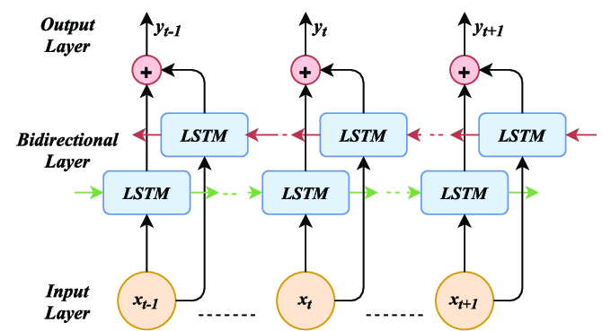
What is a Bi-Directional LSTM?
A Bidirectional LSTM (Bi-LSTM) processes a sequence in both directions:
One LSTM reads the sequence left to right
Another LSTM reads it right to left
The outputs from both directions are then combined (concatenated, summed, or averaged).

Slide 4
What is a Bi-Directional LSTM?
A Bidirectional LSTM (Bi-LSTM) processes a sequence in both directions:
One LSTM reads the sequence left to right
Another LSTM reads it right to left
The outputs from both directions are then combined (concatenated, summed, or averaged).

Slide 5
Why Use Bi-Directional LSTM?

Slide 7
Both the left and the right words matter

Slide 8
Why Bi-Directional LSTM?
In many NLP tasks, the full context of a word depends on both its left and right neighbors.
Example:
I saw a man with a telescope.
Without knowing what's after “man”, the meaning is unclear.
Bi-LSTM captures both previous and future context.

Slide 9
When to Use Bidirectional LSTMs?
Task | Should Use Bi-LSTM? | Why?
Sentiment analysis | Yes | Understand full sentence context
POS tagging / NER | Yes | Context from both sides is helpful
Machine translation | Yes (encoder side) | Capture entire sentence meaning
Text generation (decoder) | Usually No | Generation is sequential (left to right)

Slide 10
Example in TensorFlow/Keras
from tensorflow.keras.models import Sequential
from tensorflow.keras.layers import Embedding, Bidirectional, LSTM, Dense
model = Sequential([
Embedding(input_dim=10000, output_dim=128, input_length=100),
Bidirectional(LSTM(64)),
Dense(1, activation='sigmoid')
])
model.compile(loss='binary_crossentropy', optimizer='adam', metrics=['accuracy'])

Slide 11
Example in TensorFlow/Keras
The Bidirectional wrapper is used to wrap a recurrent layer
Allows RNN to process input sequences in both forward and backward directions
Internally creates two copies of the RNN layer:
One processes the input from start to end
The other processes the input from end to start
The two outputs are merged (by default, concatenated)
You can change it with merge_mode='sum', 'ave', 'mul', or None

Slide 12
Can Bidirectional Work with Other Layers?
No
Bidirectional only works with RNN-type layers:
SimpleRNN
LSTM
GRU
Not compatible with other layers such as Dense, Conv1D, Conv2D, etc.
This is because bidirectionality is a temporal concept — only meaningful when the input is a sequence over time.

Slide 13
Return Sequences vs Return State
If you're stacking RNNs:
Use return_sequences=True in the lower layers
Last layer: return_sequences=False (unless you're predicting a sequence)
model = Sequential([
Embedding(10000, 128),
Bidirectional(LSTM(64, return_sequences=True)),
Bidirectional(LSTM(32)),
Dense(1, activation='sigmoid')
])

Slide 14
Return Sequences vs Return State
return_state
Controls whether the RNN also returns the hidden state(s) at the end
Use it if you want to capture or reuse the RNN’s memory
x = Input(shape=(10, 100))
out1 = LSTM(64, return_sequences=False)(x) # Shape: (batch_size, 64)
out2 = LSTM(64, return_sequences=True)(x) # Shape: (batch_size, 10, 64)
out3, h, c = LSTM(64, return_state=True)(x) # out3 = final output, h = final hidden, c = final cell

Slide 15
Summary
Feature | Uni-directional LSTM | Bi-directional LSTM
Reads context from | Past (left) only | Past + future
Captures full context | Partial | Full
Useful for | Generation | Understanding
Common tasks | Text gen, LM | NER, QA, Sentiment

Slide 16

Questions?
"He who asks a question is a fool for a minute; he who does not remains a fool forever." – Confucius

